Slide 1
Dyn365 with TEAMS How to do this?
Kai Stenberg
blinQ AS | kai.Stenberg@blinq.no

Slide 2
Takk til våre sponsorer

Slide 3
Dyn365 with Teams
Agenda
Bio
Dyn365 Sales og Teams
Live DEMO
Dyn365 Customer Service Omnichannel Voice
Live Demo
Q & A

Slide 4

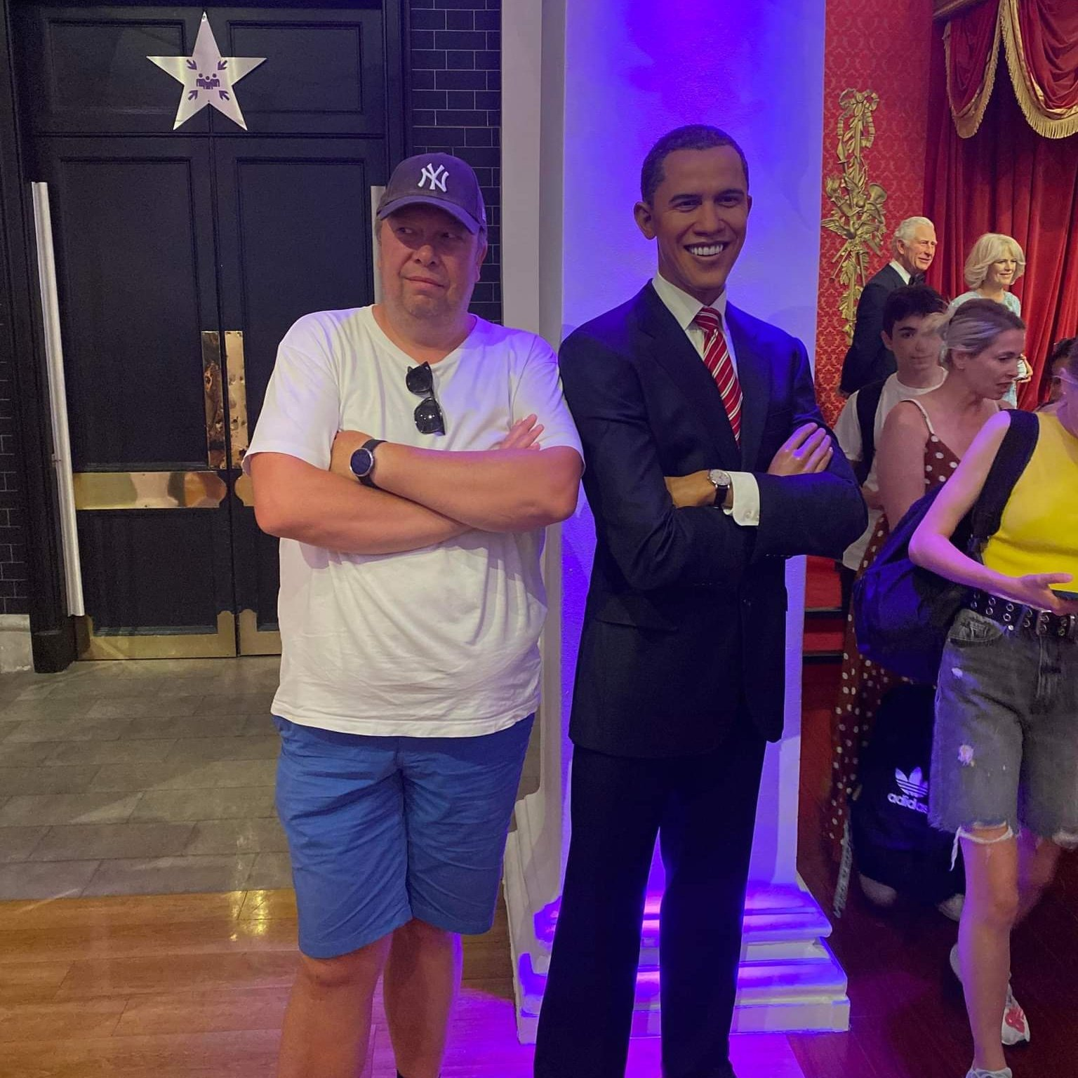
BIO
Kai Stenberg
Microsoft MVP M365 Apps & Services | TEAMS
Ansatt i blinQ AS
Podder
Blogger
Spiser Sip pakker til frokost

Slide 5
Dyn365 Sales og Teams - Telefoni
Krever Telefoni i Teams
Fungerer med
Direct Routing (egen SBC, Partner eller Telco)
Operator Connect, noe begrenset i Norge bare Telenor
Calling Plans fra Microsoft, Microsoft blir da din Telco
Calling Plans Pay-As-You-Go
Teams Phone Mobile
SBC kan vært plassert i eget datasenter. Azure kan brukes direkte fra Markedplace. (AudioCodes med flere)
Lisenser for brukere, E5 alt inkludert

Slide 6
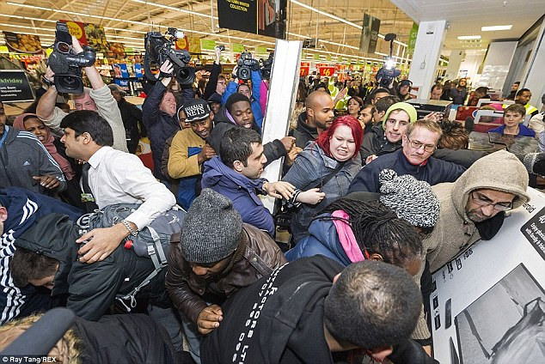
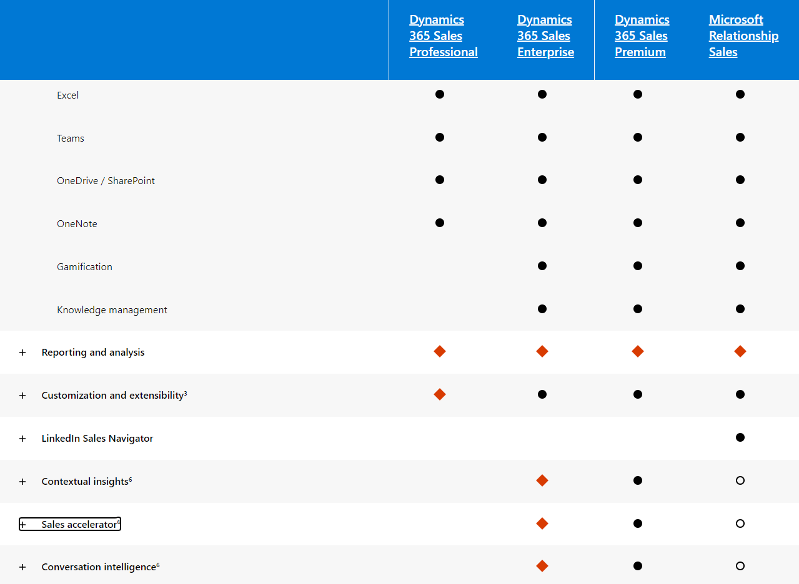
Licensing Dyn365 Sales

Slide 7
Dyn365 Sales Teams The Config

Slide 8
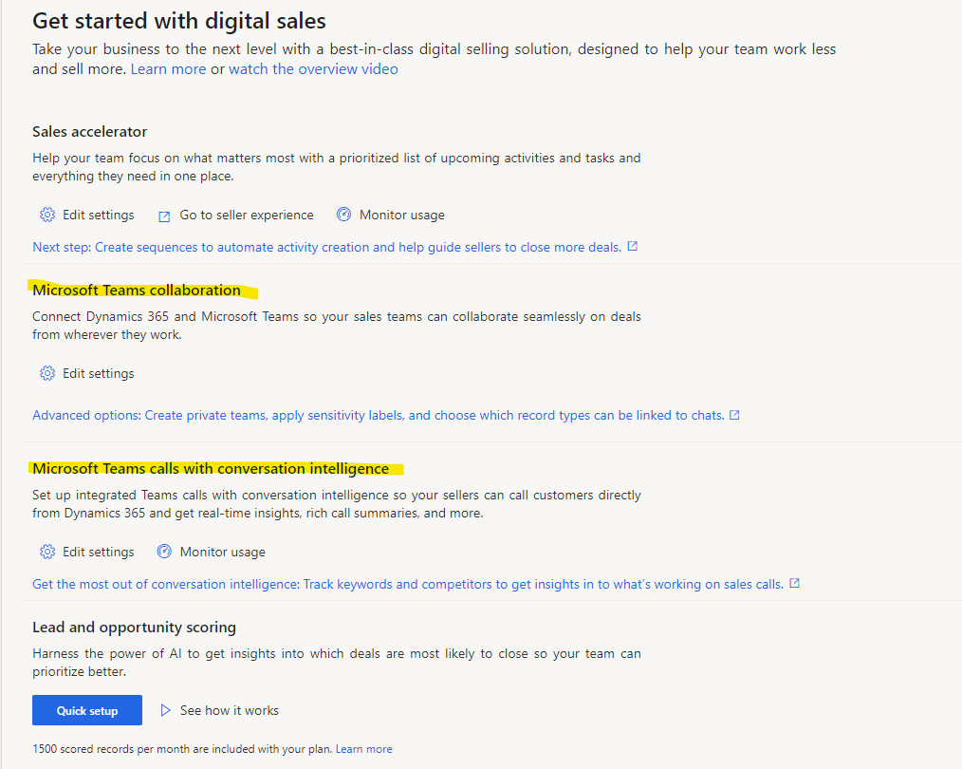
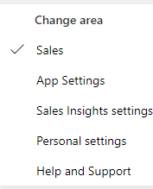
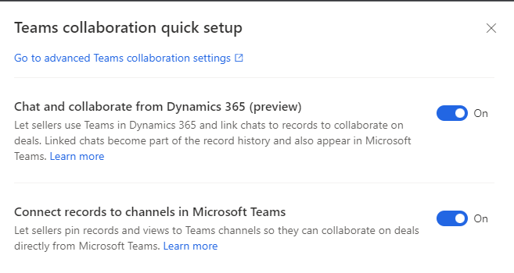
Integrasjon…hvordan gjør vi det?
Notes:
How to configure Dyn365 for Teams integration - Dial in and out to Dyn365 Sales Demo - How the integrations works - Click to call DEMO - Chat in Teams in Dyn365 sales

Slide 9
Ring ut: +4793867777

Slide 10
Ring inn: +4721417781

Slide 11
Dyn365 Customer Service Omnichannel Voice
Azure Communication Service
Kun på Direct Routing
Ikke Operator Connect (pr nå)
MicroSoft kan levere noen i noen land
Microsoft Digital Contact Center

Slide 12
Dyn365 CS Omnichannel

